Slide 1
More about Research
Reliability and Validity

Slide 2
More Research Stuff
Reliability (consistency)
Able to be repeated with similar results
Ensure conditions of experiment are always the same

Slide 3
Validity (accuracy)
Results accurately measure what is claimed
E.g Accurate timer is used to measure reaction time
Conclusions relate to the variables.
Researchers draw accurate conclusions from data
Extraneous variables may have influenced IV therefore not valid
Are your conclusions valid in ‘exercise affects reaction’ time exp?

Slide 4
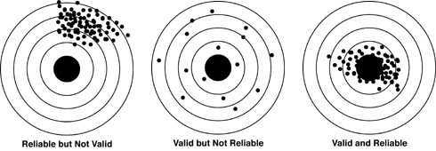
Reliability vs Validity

Slide 5
Sample and Population
Sample | Population
20 year 5 girls
50 females with red hair
25 adults with insomnia

