Slide 1
Psychology
-Is the systematic study of thoughts, feelings and behaviour and the factors that influence these.

Slide 2
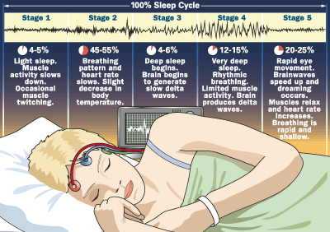
4 Levels of understanding and Sleep
the biological level of explanation,
Focuses on the biological and chemical processes underlying behaviour. Might focus on the physiological changes in the body through the various stages of sleep.

Slide 3
4 Levels of understanding and Sleep
the basic processes level of explanation,
Focuses on the psychological processes that are universal across humans. Might focus on humans’ relatively poor memory for dreams, or the cognitive processes that prevent adults from falling out of bed as they move while asleep.

Slide 4
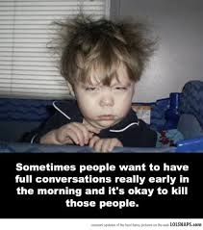
4 Levels of understanding and Sleep
the person level of explanation,
focuses on individual differences in behaviour. Might focus on individual differences — morning versus evening people, age differences, possible sleep disorders — that differentiate between people with different sleep patterns.

Slide 5
4 Levels of understanding and Sleep
the sociocultural level of explanation,
Focuses on the influence that other people exert on behaviour by studying behaviour in social and cultural contexts. Might focus on how differences in social context might influence sleep patterns.
cultural differences (e.g. the use of siestas), of shift work, and/or of aspects of the social context likely to affect sleep, such as the party-going culture of teenagers and young adults.

Slide 6
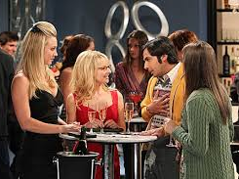
Big Bang Theory Girls Night Out
4 levels of explanation of behaviour used in Psychology

