Slide 1
Investigation design
Why do we investigate?

Slide 3
Psychology investigation design
Why do we Investigate?
Understanding is enhanced through investigation
How do we investigate?
Formulate a question based on some observations.
E.g. does exercise improve reaction time?
Hypothesize based on anecdotal evidence.
If a person engages in moderate exercise then reaction time will be improved.

Slide 4
Psychology and common sense
Sometimes people use their own knowledge to explain others or their own behaviour.
Eg -Try to explain why some people experience stress.
Psychology approaches the study of behaviour in a scientific way, using scientific method.
Empirical evidence(Data) is collected through observation or experimentation.

Slide 5
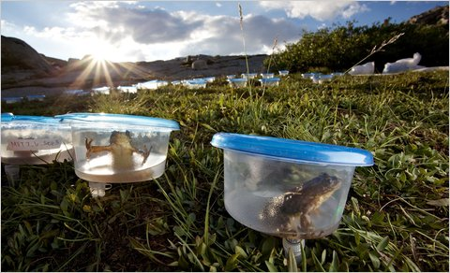
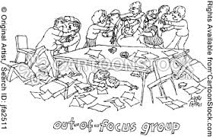
3 ways of designing investigations in psychology
Experimental Investigation
Quantitative Observational
Qualitative Investigation

Slide 6
Experimental investigation
Independent variable (something you change in an experiment to see the effect)
e.g. Exercise or no exercise
Dependent Variable – (the thing you measure once you have changed a variable)
e.g. Reaction time
Control all other variables
You need a control group vs. experimental group (the same group can be both e.g. the exercise effects reaction time experiment)

Slide 7
Experimental investigation
Extraneous variables- Variables other than IV that can cause a change in the DV
What are the extraneous variables that we could not control in our exercise experiment?

Slide 8
Experimental investigation
Extraneous Variables: categories
Placebo- improvement due to belief
Reduce through single blind method. (participants don’t know if they are control or experimental group)
Situational- noise, time, temp
Reduce by keeping the same
Participant- sex, intelligence, background etc
Keep important personality traits similar where possible
Experimenter Effects – mood, knowledge of participants
Reduce through double blind method. (experimenter and particpants don’t know if control or experimental group)

Slide 9
Experimental investigation
Random assignment (might be in control group or experimental group)- important to reduce bias
Advantages
Experiment better at eliminating extraneous variables
Manipulation determines whether there is a cause and effect relationship
Able to be repeated

Slide 10
Experimental investigation
Disadvantages
Unethical to randomly assign to a particular group
May lack external validity

Slide 11
Quantitative observational design
The criteria and or variables are pre-existing – not manipulated. E.g. part 2 of our investigation!

Slide 12
2. Quantitative observational design cont….
Advantages
Some investigations are
Unethical
Costly
Impossible
Some human behaviour can only be studied through naturalistic observation
E.g.
Violence in children's games
Effect of Domestic Violence

Slide 13
2. Quantitative observational design cont …..
Disadvantages
Can’t infer strong cause and effect link (extraneous variables cant be controlled)
No random assignment

Slide 14
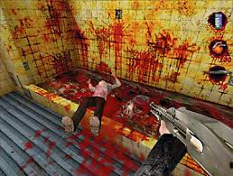
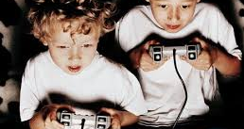
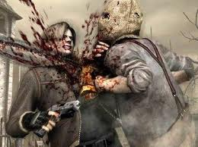
Unethical Studies

Slide 15
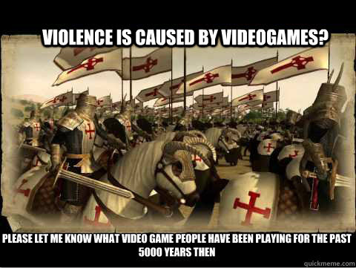

Slide 16
Qualitative Observational Design
Collects only Qualitative Data via:
Focus Groups
Obtains data through group interview – talk to one another – ask questions – exchange personal experiences and opinions.
People can explore their experiences/attitudes and clarify thoughts.
Content Analysis OICKA
Organise
Identify Themes
Code Themes
Keep Track of Themes
Analysis

Slide 17
Focus groups
Advantages
Richness of the quality of data – attitudes and experience
Some ‘open up’ more in a group setting (c.f 1 – 1 interview)
Simple to organise

Slide 18
Focus groups
Disadvantages
May be influenced by stronger members opinions or opinion disregarded
No confidentiality
Should not be interpreted as representative of other groups of people
Some members not comfortable sharing views.
Data can be time consuming to analyse

Slide 19
Qualitative Observational Design
Delphi Technique
Uses experts – with expertise in the area in question
Often used to find solutions
E.g. Ideas for methods to reduce young drivers from ‘hoon driving’
Experts include psychologists, teachers, police, paramedics
Members don’t have to meet

Slide 20
Delphi – how is it done?
Recruit members
Construct and distribute questionaires
1st circulation and return
Collation and categorisation
2nd circulation
Collation
Summary

Slide 21
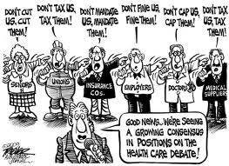
Delphi

Slide 22
Qualitative Observational Design cont…….
Advantages of Delphi
Cheap
Informed people
Reduces the disadvantages of face to face meetings
Ensures participants consider alternative views

Slide 23
Qualitative Observational Design cont ……
Disadvantages
‘Forces’ consensus – because no discussion
Opinions may be weakened.
Data can be time consuming to analyse

